Slide 1
Real-time ML Journey
MicrosoftML + Revoscale
Hiram Fleitas
Senior Customer Engineer
Microsoft Data & AI
badges

Slide 2
About Me
Machine Learning
Synapse Analytics
Power Platform
DevOps
aka.ms/hiram

Slide 3



















Industries
1995
1999
2000s
2017
2021
Legal, Medical, Retail, Travel Insurance, ISV, HR, Cruise Line, PnC Insurance, plus more…

Slide 4














Technologies
2017
2018
2019
2020
2021

Slide 5

Journey steps
1
2
3
4
5
6
7
8
Iris
Ski
Text
Forms
Image
LoS
Price

Slide 6
Agenda
$30M
$200K
$2M
$500M
$40M
$200K
Sentiment
QnA Chat Bots
Forms
Capital Modeling
Length of Stay
Search by Photo
with impact

Slide 7

Sentiment $30M

Slide 8
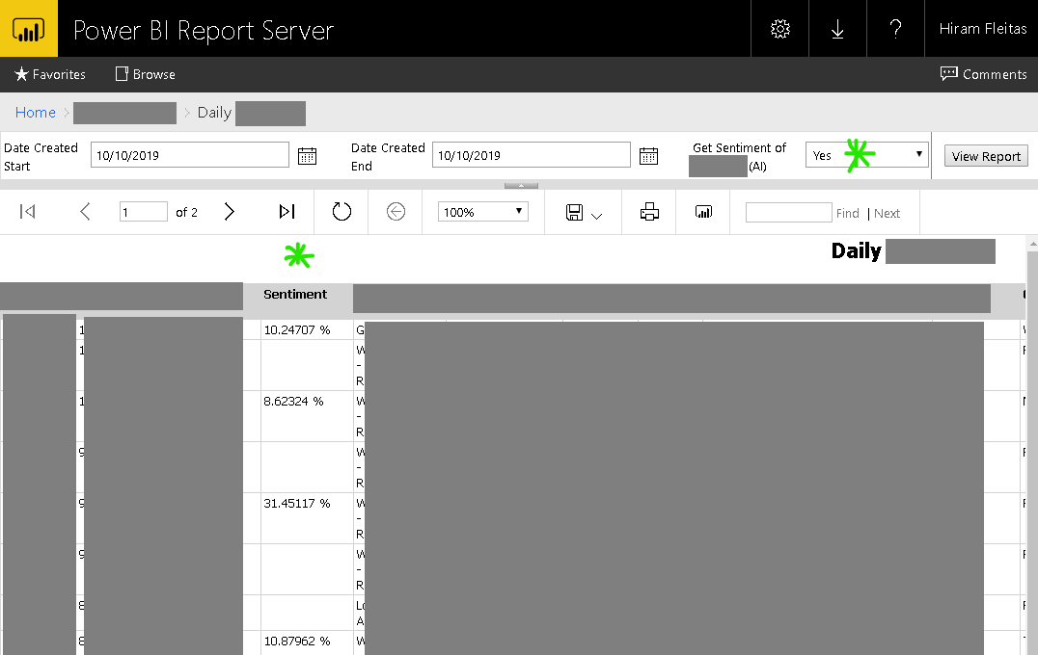
Sentiment in Paginated Report
Learn more:
Hide Column based up Parameter Selected SSRS
Notes:
Script to share scenerios of ML used at some companies.

Slide 9
SQL Stored Proc w/ Python – Sentiment Cognitive API
create or alter proc GetCognitiveAPIQuoteSentiment
as
set nocount on;
declare @py nvarchar(max);
set @py = N'import requests, pprint as pr
from pandas.io.json import json_normalize
apikey = "mykey"
api = "https://eastus2.api.cognitive.microsoft.com/text/analytics/v2.0/"
url = api + "sentiment"
df = jsondocs
headers = {
"Ocp-Apim-Subscription-Key": apikey,
"content-type": "application/json"
}
response = requests.post(
url,
headers = headers,
data = df.iloc[0][0].encode()
)
rds = response.json()
df2 = json_normalize(rds, "documents")
pr.pprint(rds)
print(type(df2),df2,sep="\n")
';
drop table if exists apiresults;
create table apiresults (id int, score float);
insert into apiresults
exec sp_execute_external_script @language = N'Python'
,@script = @py
,@input_data_1 = N'select * from JsonQuotes'
,@input_data_1_name = N'jsondocs'
,@output_data_1_name = N'df2'
select * from apiresults;
update q
set q.Sentiment = a.Score
from Quotes q
inner join apiresults a
on q.quoteid = a.id
where q.Sentiment is null;
go
Learn more:
Trollhunters.ipynb, Native scoring with T-SQL PREDICT

Slide 10
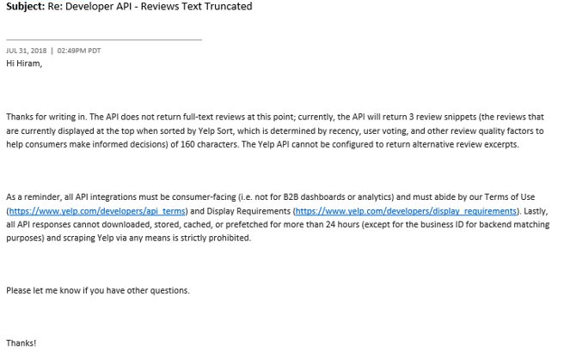
Responsible AI
Learn more:
yelp.com/developers/api_terms
yelp.com/developers/display_requirements

Slide 11
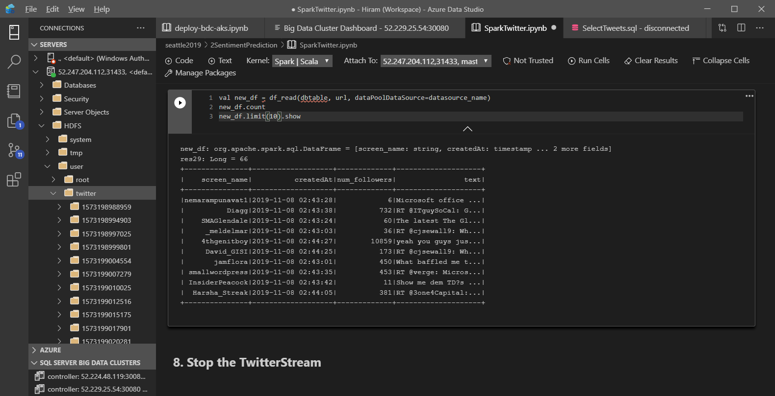
Learn more:
SQL Server Samples - Big Data Clusters - Spark

Slide 12
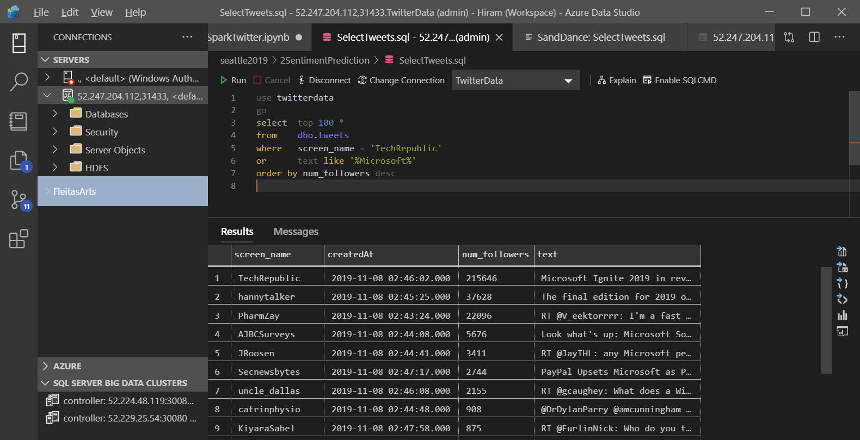
Learn more:
SQL Server Samples - Big Data Clusters - Spark

Slide 13
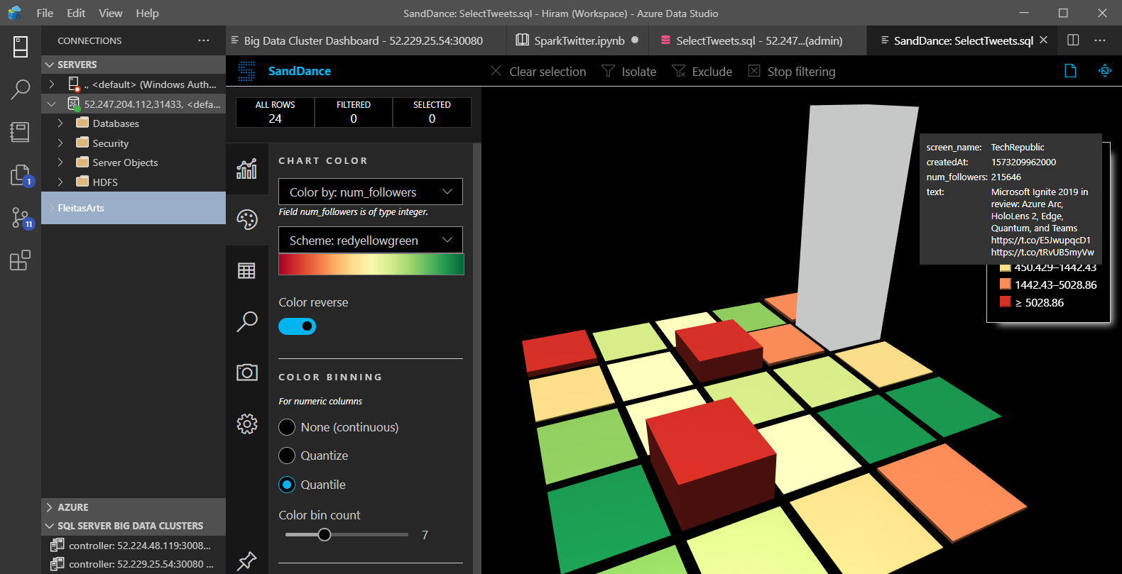
Learn more:
SQL Server Samples - Big Data Clusters - Spark

Slide 14
QnA Chat Bots $200K

Slide 15
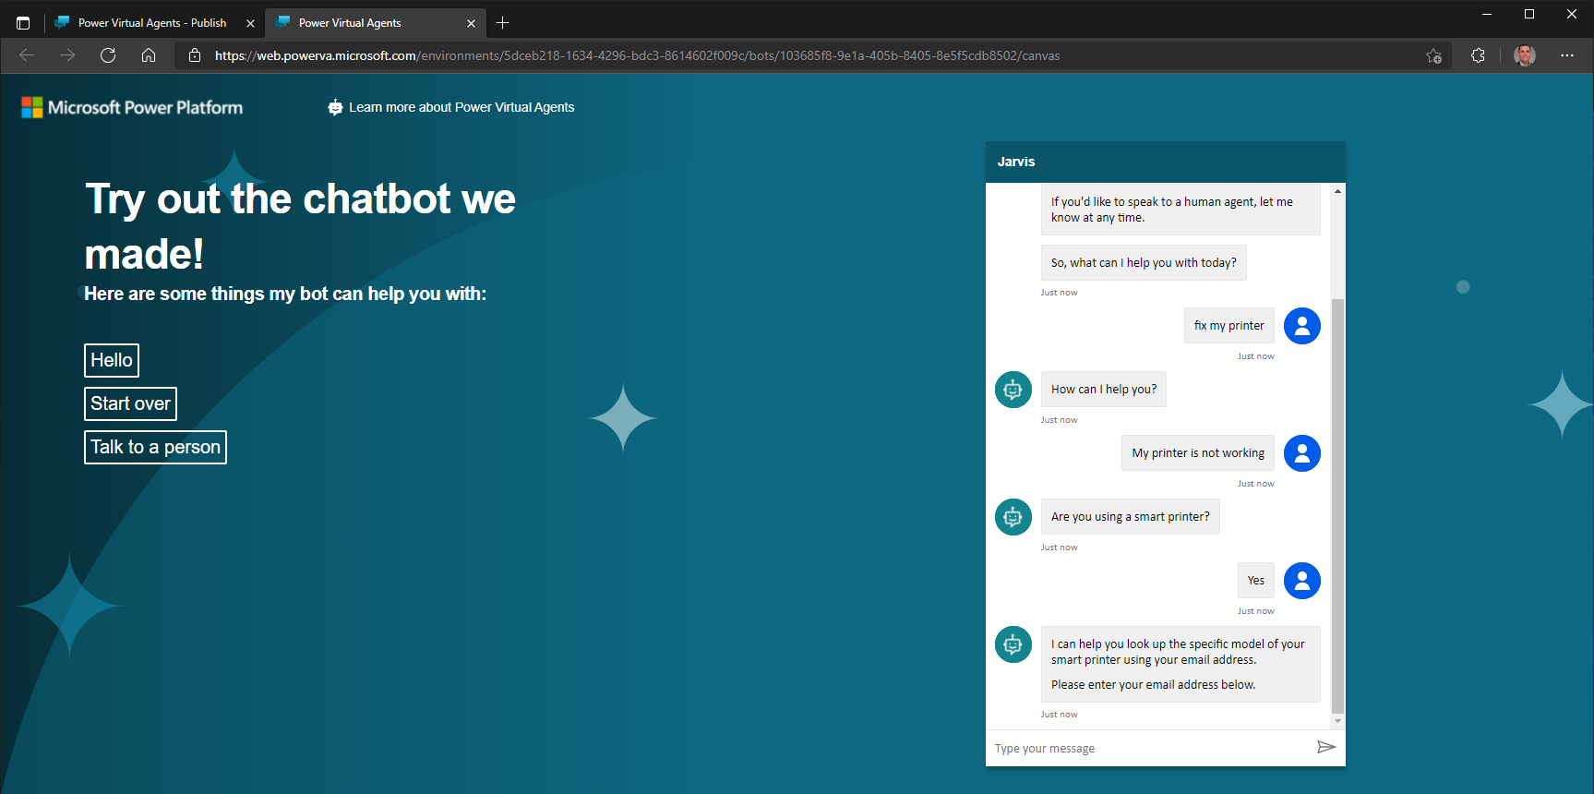
Learn more:
PVA - Build Printer Troubleshooting Bot
Notes:
Helps towards training – onboarding.

Slide 16
Forms $2M

Slide 17
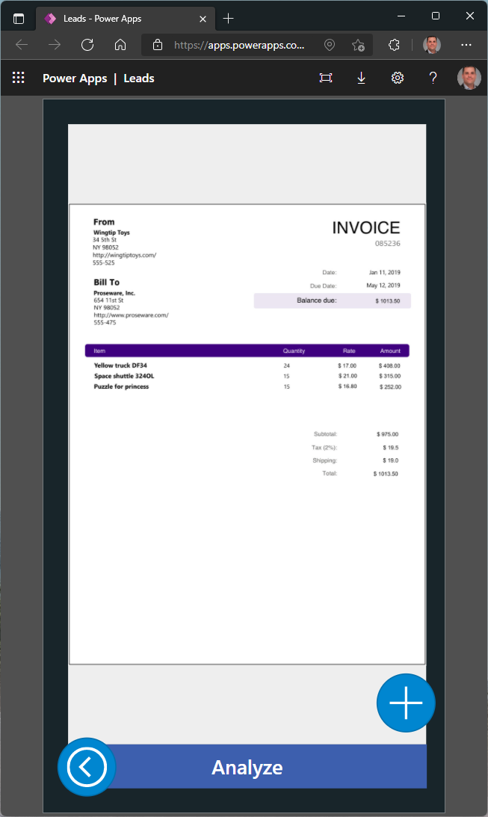
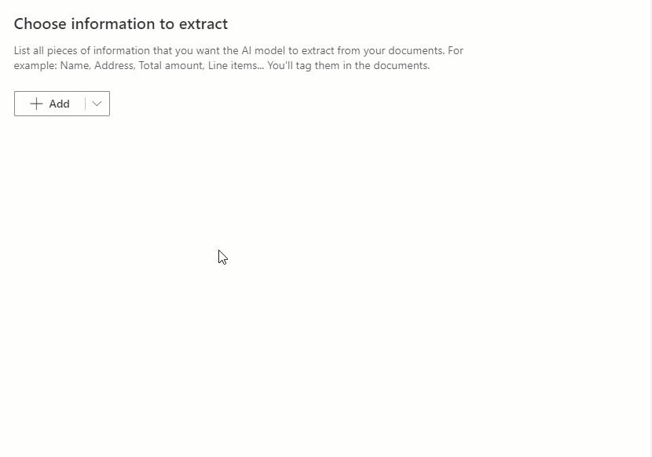
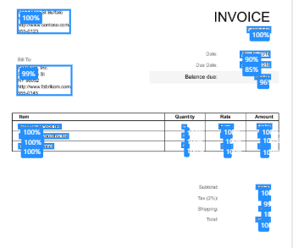
Learn more:
Form Processing - Create first model

Slide 18
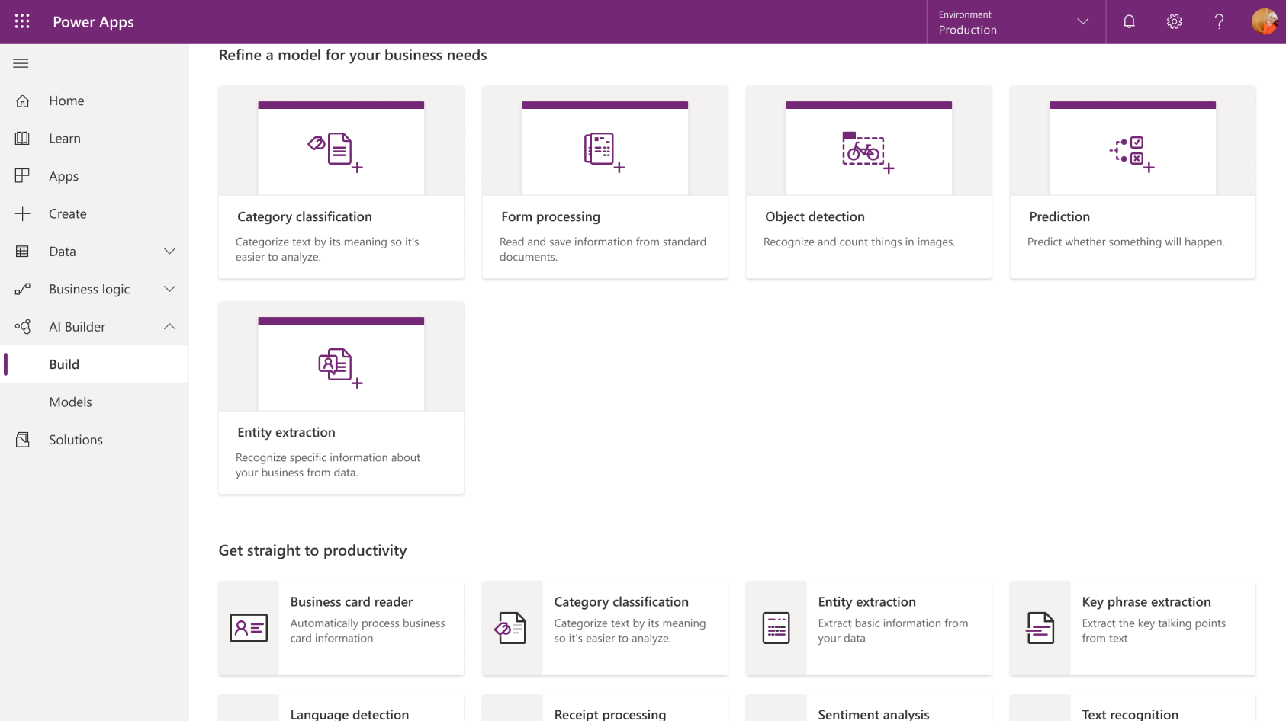
Power Apps - AI Builder

Slide 19
Capital Modeling $500M

Slide 20
Digital Transformation We are people, not interfaces
Before
7 User touchpoints
4 Unique manual processes
Many different files and folders
Significant user downtime
After
1 Single pipeline
3 Primary stored procedures
1 SQL Server
Minimal user downtime

Slide 21












Digital Transformation We are people, not interfaces
Before
x4
x4
x4

Slide 22
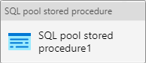

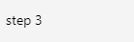
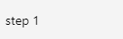
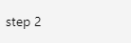
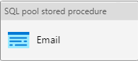
Digital Transformation We are people, not interfaces
After

Slide 23
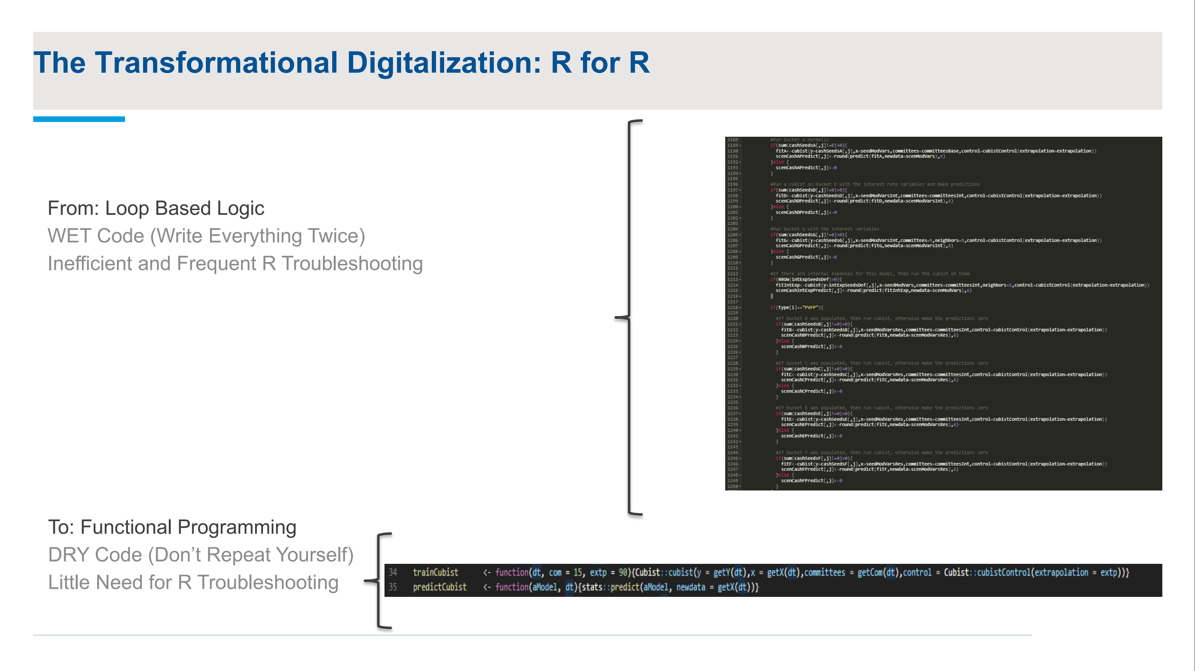
Digital Transformation We are people, not interfaces
Before
Loop based logic
WET (Write Everything Twice)
Inefficient
Frequent R troubleshooting
After
Functional programming
DRY (Don’t Repeat Yourself)
Little need for R troubleshooting

Slide 24
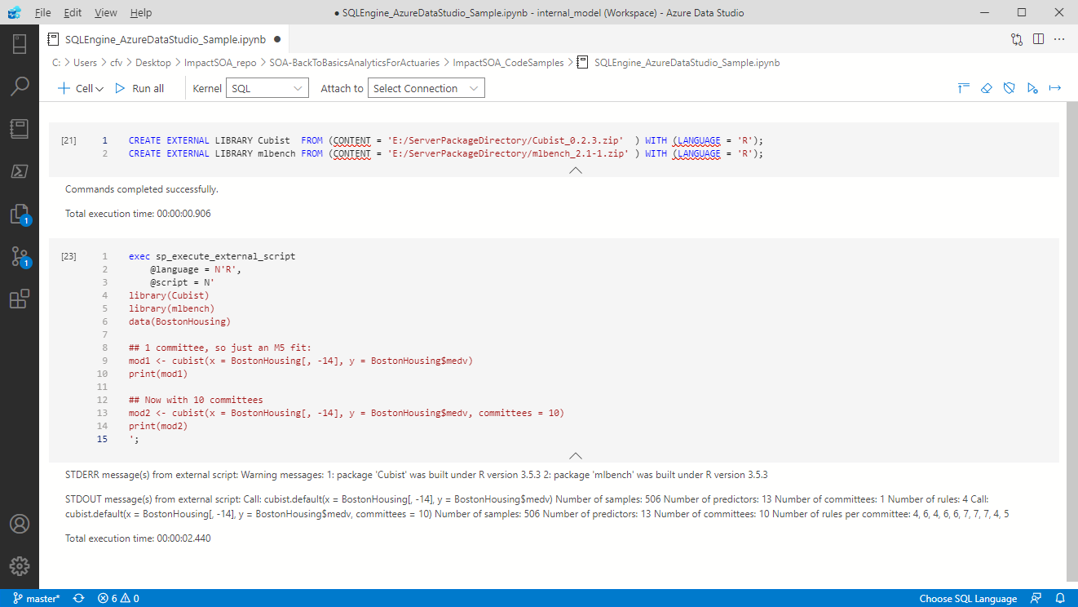

Learn more:
CapitalModel.ipynb

Slide 25
How to reproduce or get started?
Identify manual data processes & transformations of high value (ROI).
Simplify by consolidating workloads (leverage cloud).
Democratize understanding by sharing knowledge.
Accelerate business value for down-stream consumers/users.
aka.ms/mlsqldev
aka.ms/adf/azurelearn
RStudio Cheatsheets - RStudio

Slide 26
Length of Stay $40M

Slide 27
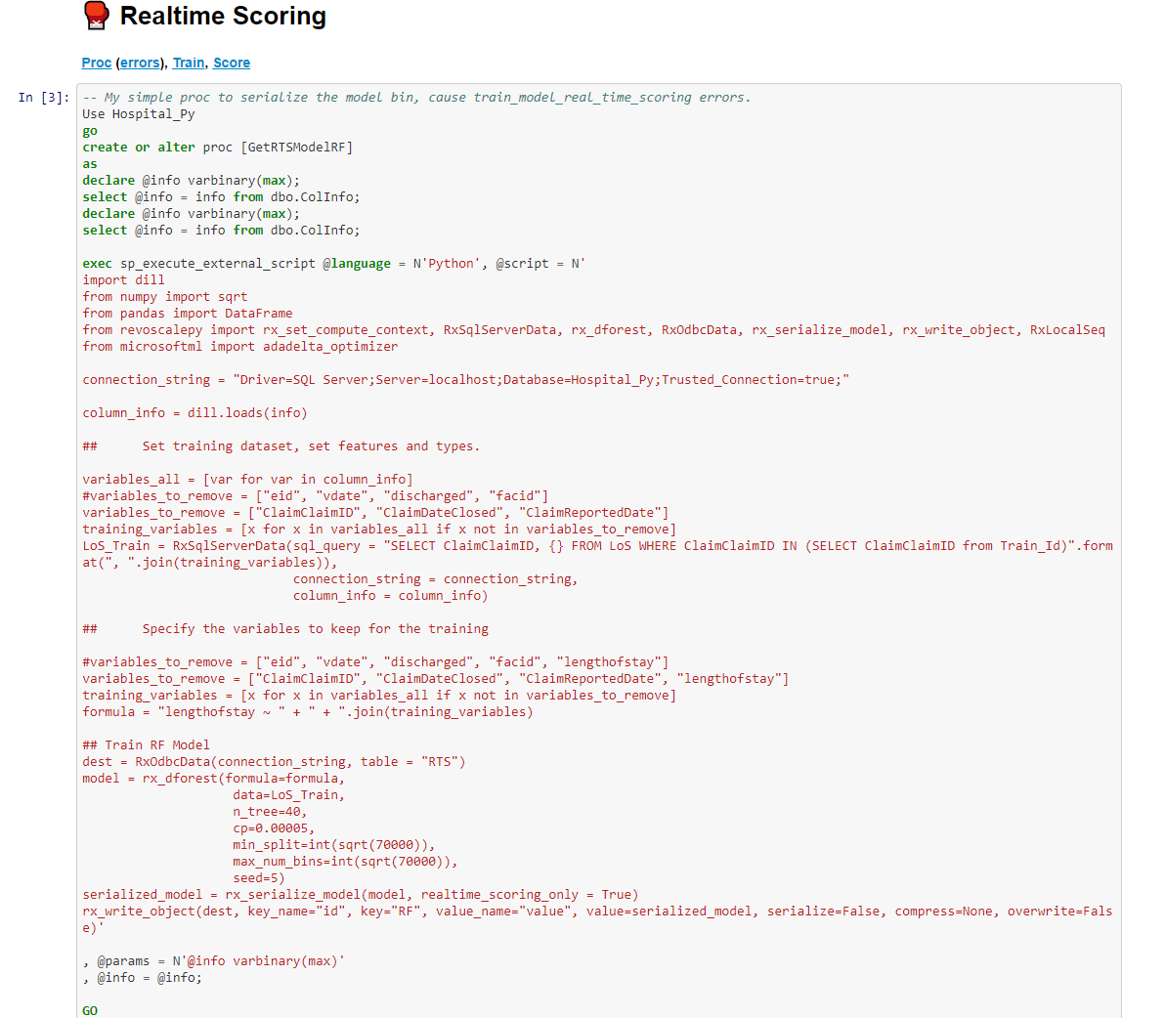
Learn more:
LoS - Realtime Scoring

Slide 28
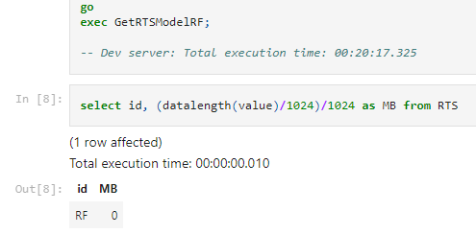
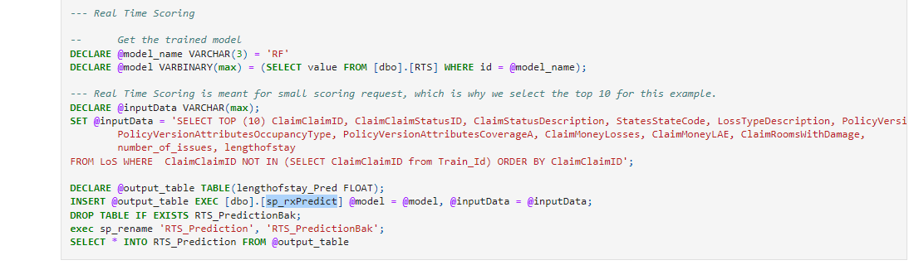
Learn more:
LoS - Realtime Scoring

Slide 29
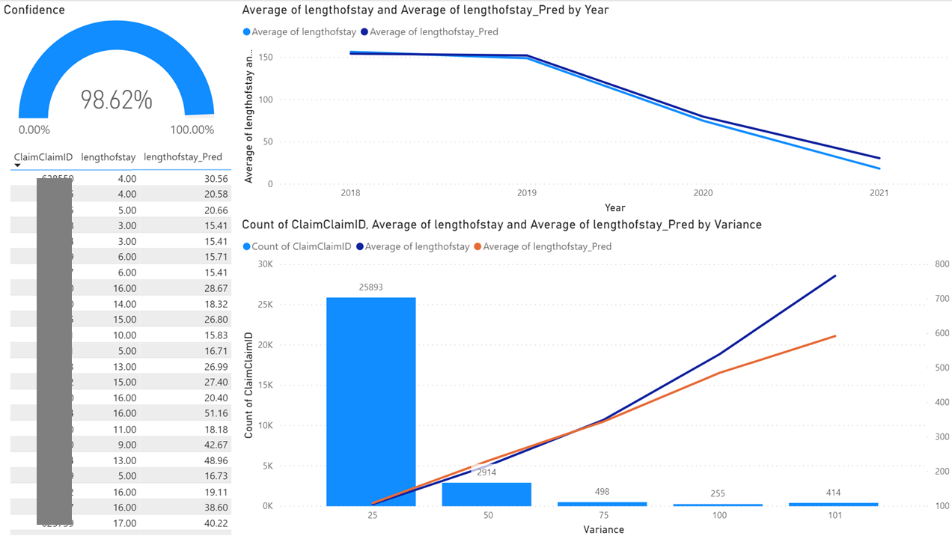
Power BI – Claims Model Accuracy

Slide 30
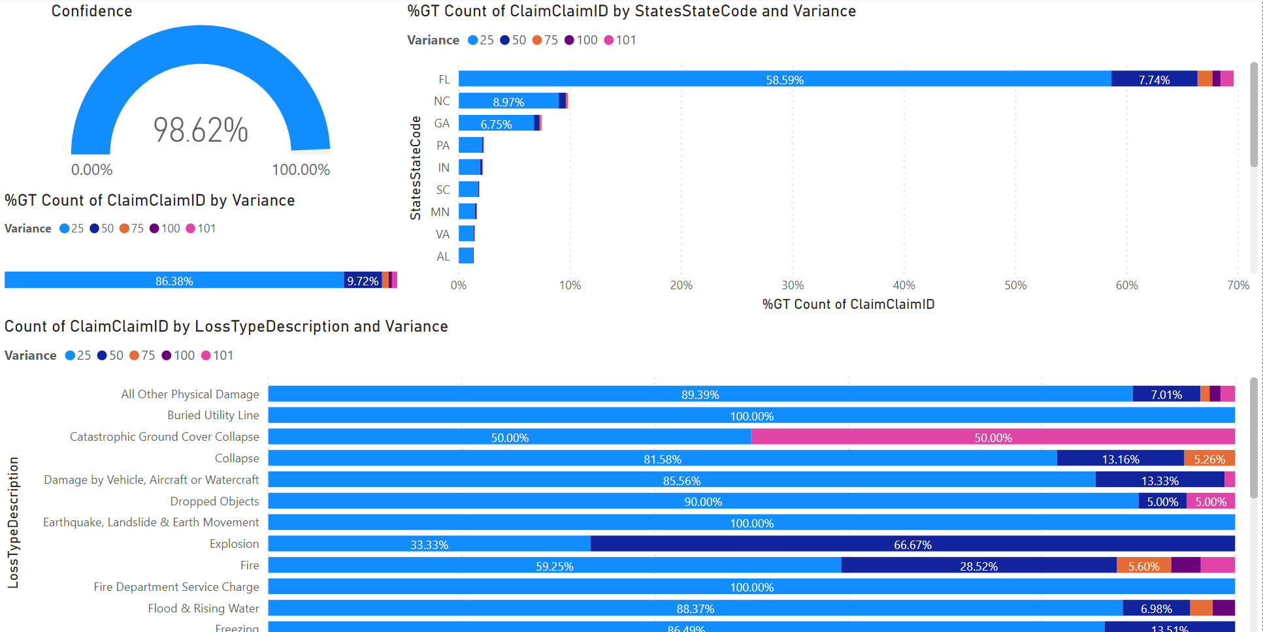
Power BI – Claims Model Accuracy
Learn more:
http://localhost:3000

Slide 31
Search by Photo $200K

Slide 32
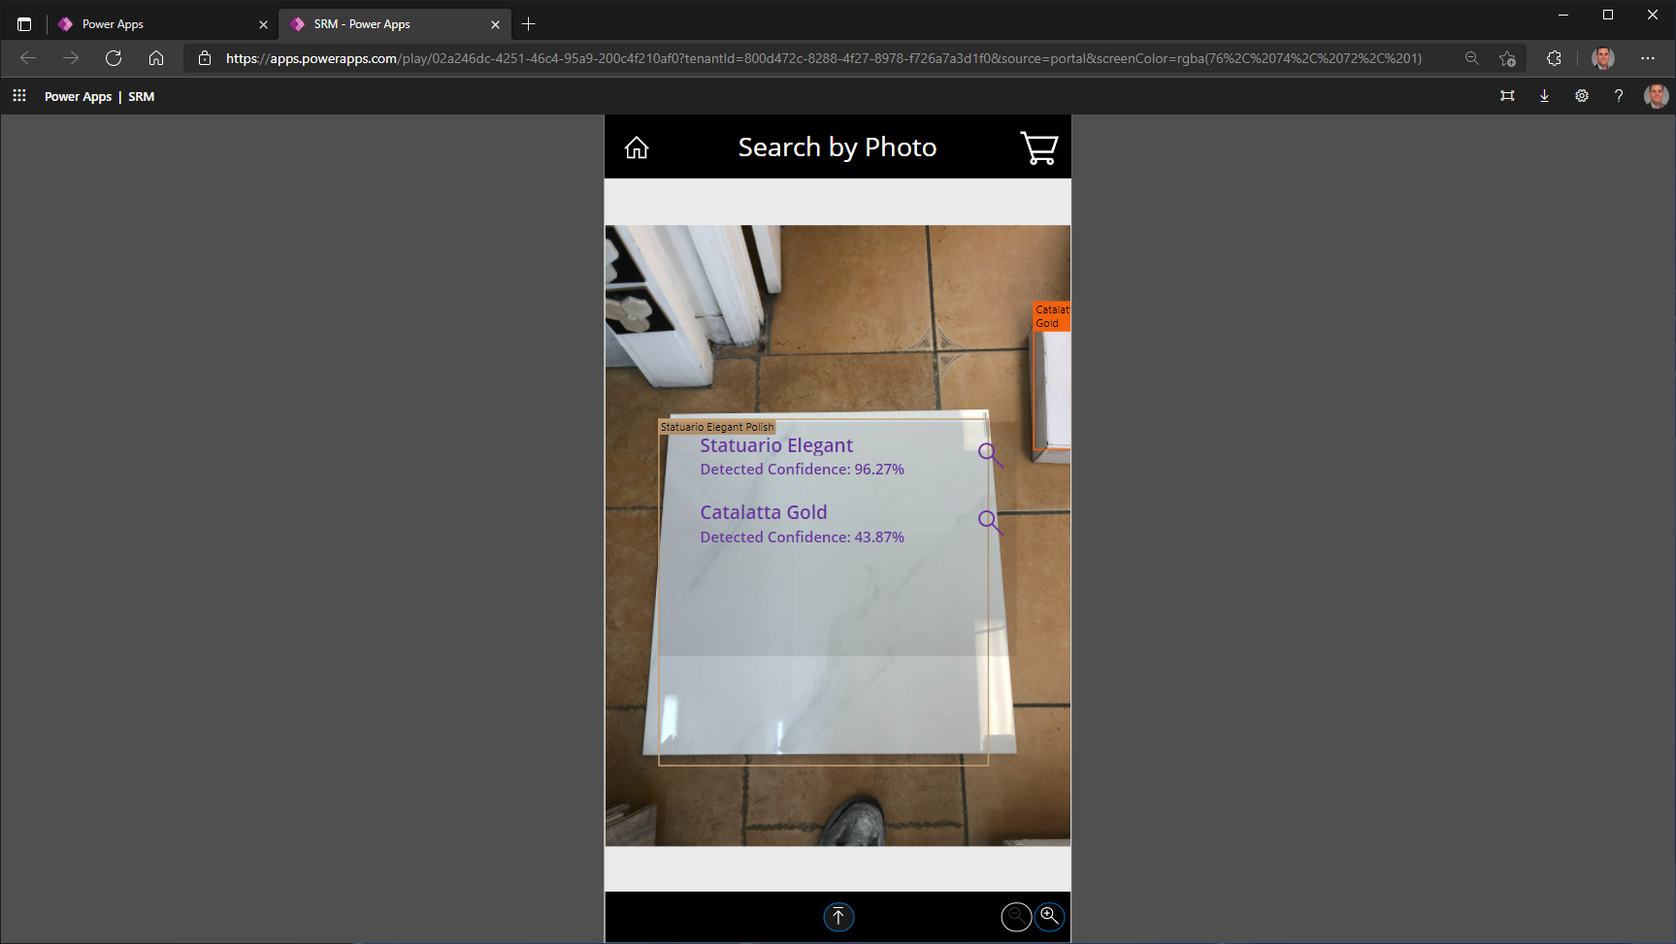
Power Apps – Object Detection

Slide 33
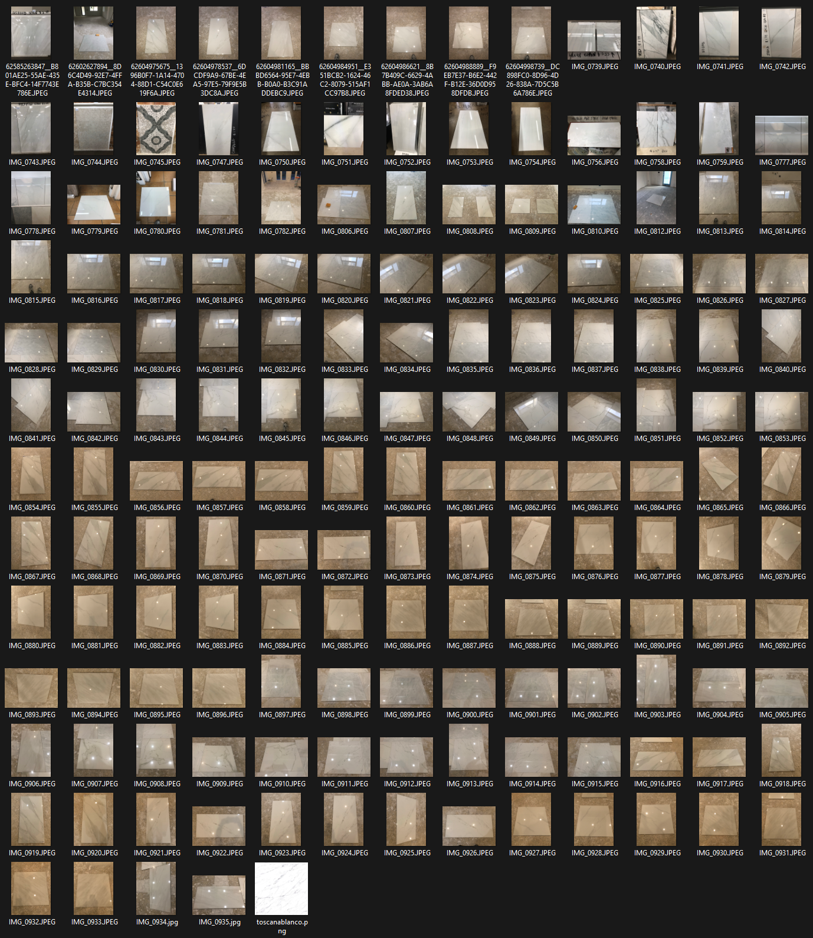

Object Detection Datasets Attempts
~1 background
161 photos, 15 angles
(Fail)
5 backgrounds
139 photos, 4 angles
(Successful)

Slide 34
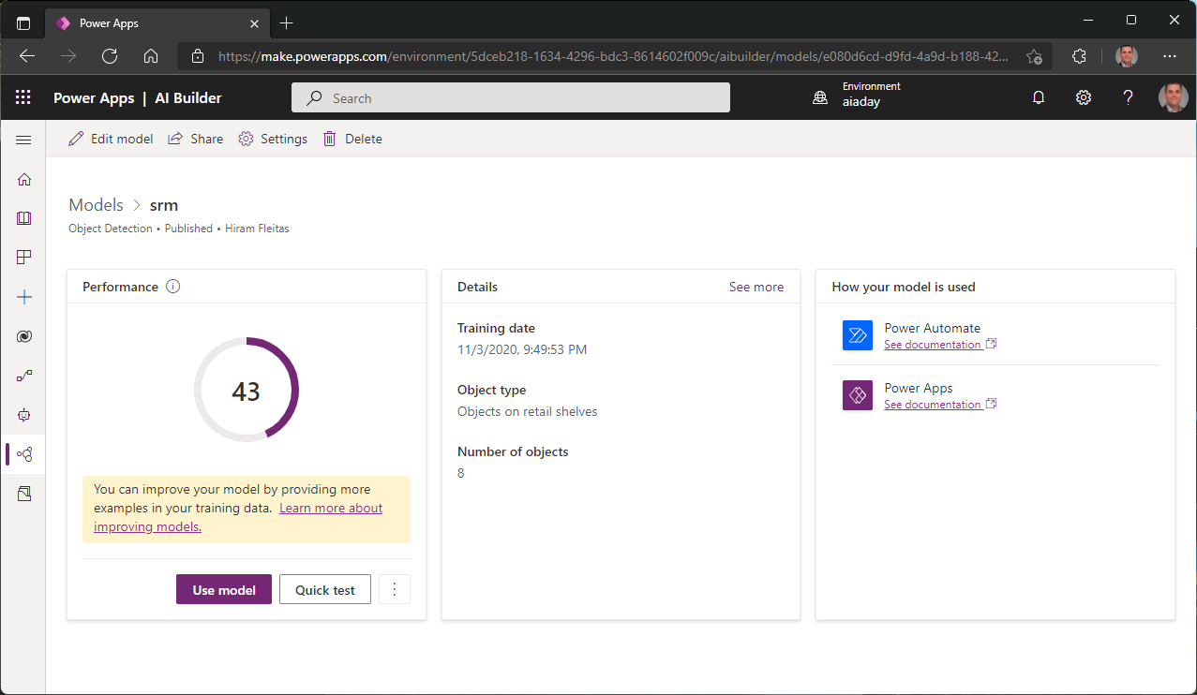
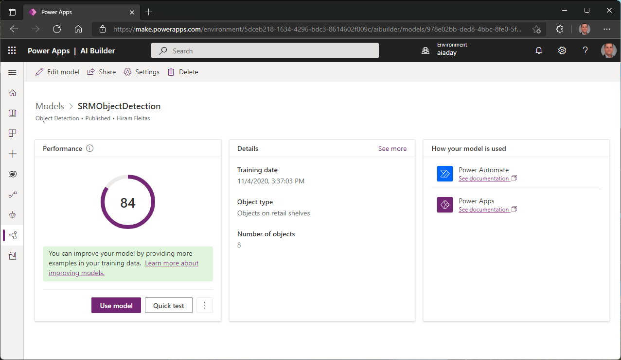
Power Apps – Model performance
Learn more:
Use more diverse images
Interpret performance score

Slide 35
Bonus
E2E_MLFLOW_Sklearn_ADLS

Slide 36
Summary
Sentiment
QnA Chat Bots
Forms
Capital Modeling
Length of Stay
Search by Photo

Slide 37
Journey steps
1
2
3
4
5
6
7
8
Iris
Ski
Text
Forms
Image
LoS
Price

Slide 38
Additional Resources
Repo1 (SQL, Python, JS on Node, Power BI)
Repo2 (SQL BDC, Spark/Scala, Python, Azure Cog API, Paginated Reports)
Repo3 (Synapse, DevOps, In-DB ML, R, Purview)
Video (3 minutes)
Video (1 hour)
PREDICT in Synapse Spark using model registered in AML or ADLS
SynapseML
Native scoring with T-SQL PREDICT

Slide 39
Feedback Snippets
CSAM
Invaluable assistance.
The right skills at the right time.
Improved remarkably in one working session with Hiram.
CSAM APDM
Incredible expertise
Flexible in going in different directions
Good balance of customer obsession
Operates under the One Microsoft mantra
S500 Customer
Helped us successfully solution, setup, configure
he was able to get us running in less than a week.
HUGE Millstone.
Helped us deliver almost real time reporting
S500 Customer
We could not have completed this without Hiram
His work and dedication to the project was excellent
CSAM
He’s been our best from the Data and AI space.
Recently won an Azure compete over AWS for Inventory Management and Predictive Maintenance.

Slide 40
Thank you
Hiram Fleitas
aka.ms/hiram

